Slide 1


The basics of Markdown

Slide 2

What is Markdown?
Markdown is a lightweight markup language
Create formatted text using a plain-text editor
Main goal is to make writing for the web more accessible, prioritizing readability and ease of use
Created by John Gruber and Aaron Swartz in 2004

Slide 3
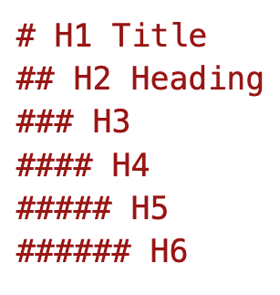
Headings
Use 1-6 hash (#) symbols to indicate the heading level
One H1 per markdown file. This is the title.
Avoid using bold or other markup in headers

Slide 4

Formatting
Bold – **Use asterisks for bold text**
Italic – _Use underscore for italicized text_

Slide 5
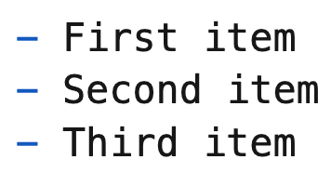
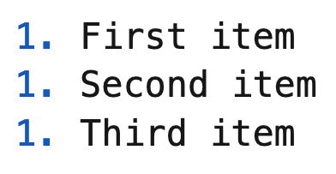
Lists
Unordered lists
Use the hyphen character (-) for list item bullets
Ordered list
Use number 1 for all list items

Slide 6

Links and images
Links
[title](https://www.example.com)
Images
![alt text](image.jpg)

Slide 7

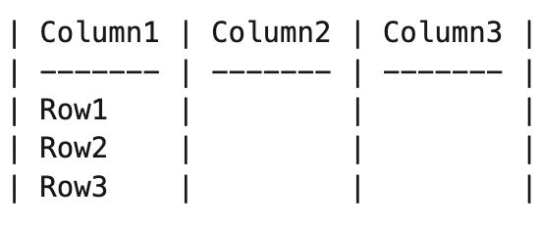
Tables

Slide 8
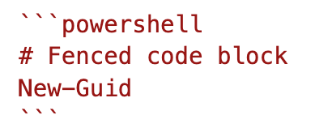
Code
Inline code
Use `Get-Help` to learn how to use a command in PowerShell.
Fenced code block

Slide 9

Line length
Use semantic line breaks to limit line length
Conceptual = 100 characters
Reference = 100 characters
About = 80 characters
Reflow Markdown extension

